Slide 1



Guide for GCBSS participants via zoom
13th Global Conference of Business and Social Sciences 2022
17TH – 18TH JUNE 2022
GRAND MILLENNIUM KUALA LUMPUR (5 STAR), Malaysia
(IN-PERSON AND ONLINE)

Slide 2

Guide for GCBSS Participants Via Zoom
This quick start guide gives you an introduction to the essentials of joining and participating in GCBSS 2021 Online Conference via Zoom.
Download Zoom App to your
computer or mobile device.
It is advisable to use a desktop, laptop
or tablet (preferably not mobile phone).
If using a laptop, please plug-in to power
as running on battery can adversely
affect video quality. If using a mobile
device, please ensure that the battery
is fully charged.
Please find a quiet room with no echo, for good audio quality and good lighting so that your face does not appear in a shadow. If possible, have some soft lighting to illuminate your face (e.g., in front of a window)
Pick a comfortable location to sit, with an uncluttered background. Please do not sit near a fan due to the noise it generates.
Note: If using a desktop or laptop, connect to the internet via a wired ethernet jack which gives faster and more consistent internet access than Wi-Fi.

Slide 3


Guide for GCBSS Participants Via Zoom
Your Device
CAMERA:
Position your device so that you are looking into the camera at eye-level rather than looking down (e.g. place your laptop or tablet on a box).
Your camera should be about an arm’s length away from you and adjusted such that your eyes appear around one third from the top of the frame.
HEADPHONES:
Headphones or earbuds are highly recommended to avoid audio feedback during meeting.
On Camera Suggestions
While there is no mandatory dress code,
wear something smart casual to look presentable. Presenters are also encouraged to wear formal or traditional attire.
Keep your head and body relaxed but reasonably still throughout the webinar. Excessive movement (bobbing of head, moving from side to side, front and back) is distracting and may cause video pixilation/camera focusing issues.
Test your device, set up as outlined above at least 1 day before the webinar including your video, audio and internet connection.
Join a Test meeting to familiarize yourself.

Slide 4

HOW TO JOIN A SESSION
A quick guide on how to join Opening Session, GCBSS workshops and concurrent sessions, features on Zoom and some useful tips to get most out of GCBSS In-Person and Visual conference.

Slide 5
How to join a session
GCBSS Host will send an email invitation to join these sessions. In the email there should be a link to the session as well as the provided password.
To access the session, click on the link which will take you to another page in which gives you the option to launch or download Zoom (if you haven’t downloaded Zoom yet).
Once you have launched Zoom, there will either be a pop-up that says Waiting for the host to start this meeting meaning that the session has not started yet, which is good time to check your audio quality and explore the settings.
You can also view all the upcoming Zoom meetings in the Meetings tab and select the meeting that you want to join.
https://support.zoom.us/hc/en-us/articles/201362193-Joining-a-Meeting

Slide 6
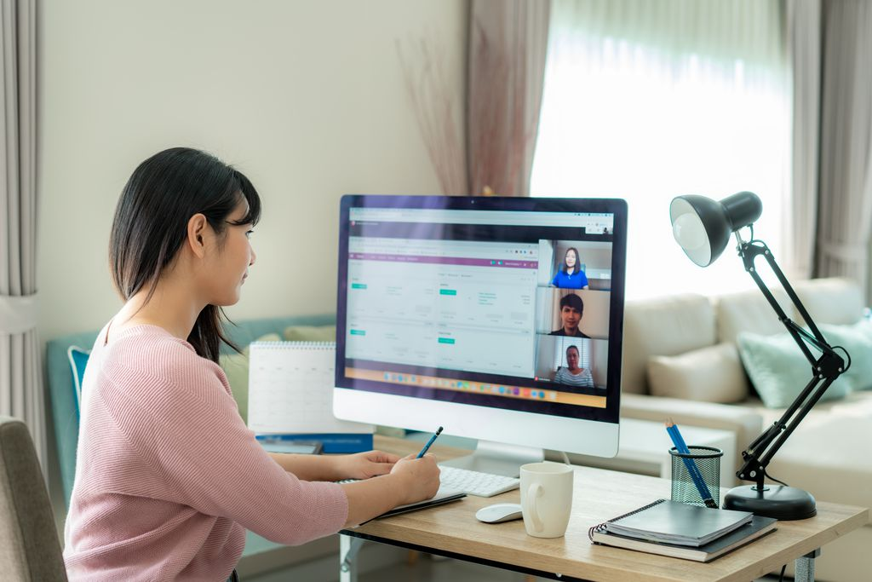
HOW TO SHARE SCREEN
Guide for plenary speakers and presenters on how to share screen during a session. In Zoom, both hosts and participants can share their screen. However, participants cannot share if the host is already sharing or if the host has disabled this feature for participants.

Slide 7
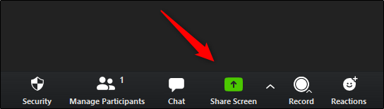
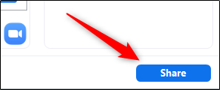

How to Share Screen
Click the share screen button on the menu bar.
Select the desktop or application you would like to share or select whiteboard to share a whiteboard. Selecting Screen will allow you to share any open window on your computer.
Note: Make sure the application (Word, PowerPoint, Chrome, etc) you’d like to share is open before you start sharing your screen.
Click the Share button in the bottom-right corner of the window.
To stop screen sharing, click the red Stop Share button at the top of the screen you are currently sharing.

Slide 8
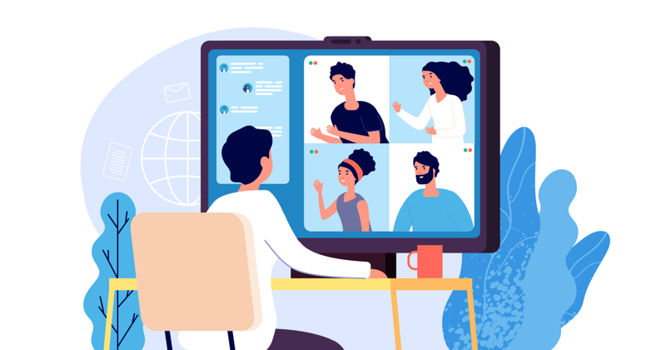
INTERACT AS A PARTICIPANT
As a participants, you are able to interact through out the session with features such as Sharing a Reaction, Providing Nonverbal Feedback and Sending message with Chat. Here’s a guide on how to use them.

Slide 9
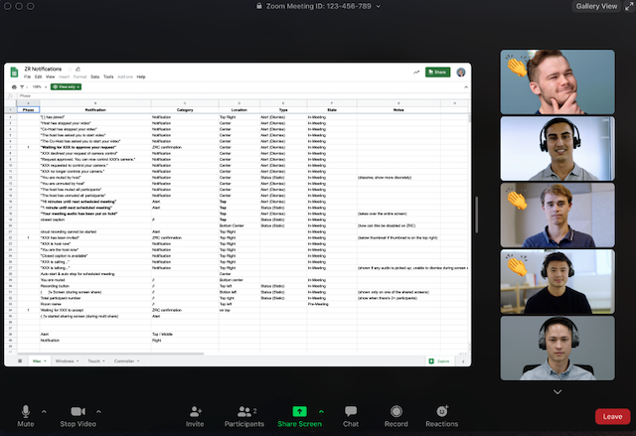

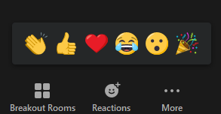
Sharing a reaction
Participants can react during speech or presentation by an emoji to communicate without interruption.
In your meeting controls,
click Reaction's button
Click the type of reaction you would like to send:
The reaction will display for
5 seconds.

Slide 10

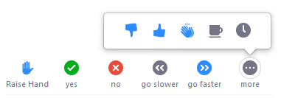

Providing Nonverbal Feedback
Nonverbal feedback icons allow you to indicate to the host that you have a question, let the host know what you are thinking without interrupting and respond quickly to questions or prompts from the host.
Click the Participants button.
Click one of the icons to provide feedback to
the host.
Click the icon again to remove it.
For example, by clicking Raise Hand places the raise hand icon beside your name to simulate a hand raise.
All participants can see the icons that everyone else has chosen.
The icon will appear next to your name in the participants list.
Note: You can only have one icon active at a time.

Slide 11
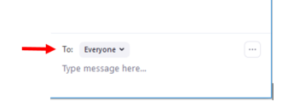
Send messages with Chat
You can send a chat message to all participants in the meeting or privately to specific individuals.
Send a Message to Everyone
Click the Chat button in the menu bar to open the Chat panel.
Type your message in the Text box at the bottom of the panel and press Enter to send the message.
Send a Private Message
You can send a private message to a single person by clicking the down arrow in the To: field and selecting the person's name from the list.
Note: The person's name will stay selected until you click the down arrow again and select Everyone (In Meeting).

Slide 12
Using Annotation Tools
Some sessions, presenters might share an online whiteboard and ask participants to participate in the session by using annotation tools.
To use the annotation tools, while viewing a shared screen or shared whiteboard,
click View Options then Annotate at the top.
You will see these annotation tools:
You will be able to insert text, lines, arrows, shapes, and predefined icons like a check mark or a star.
You will also be able to display spotlights and arrows that display your name.

Slide 13

Listening to language interpretation
While most of the conference sessions will be conducted in English, interpretation for some languages will be available for some of the sessions.

Slide 14
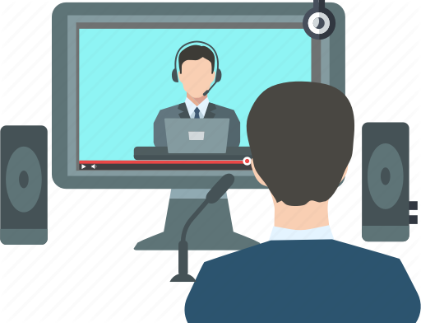
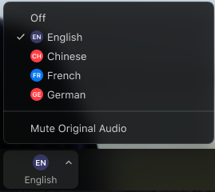
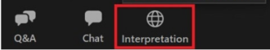
How to conference in other languages?
Select the language that you would like to hear.
Click on the globe icon for interpretation
(at the bottom right of your screen).

Slide 15
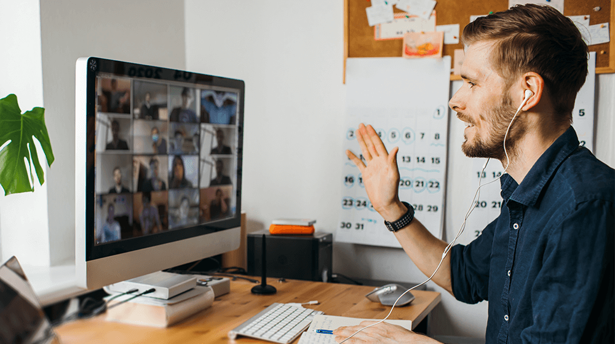
Zoom Best Practice Tips
On audio-visual quality and setting – lighting and space

Slide 16

Audio-Visual Quality
Image Quality
Use a quality camera with reactive auto-focus and lighting-correction capabilities.
If you do not have a built-in camera, use your mobile device and position it in landscape mode (i.e. horizontally)
Shut down Other Programs
Restrict other programs that you run to what you will need during the Zoom session and keep this to a minimal. Shut down all other programs.
This will optimize your audio-visual quality and bandwidth for the session.
Sound Quality
If possible, invest a good quality headphones to produce better quality audio.
You may also use the earphone with microphone that came with your mobile device but be mindful of the static this may create from movement.

Slide 17


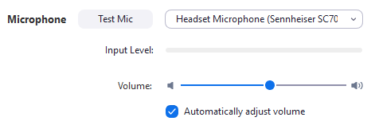
Testing Audio Quality
Testing your device
Join a meeting, then click
‘Test speaker and microphone’.
A pop-up display to test your speakers.
*If you do not hear the ringtone, select a different speaker until you hear it.
Once you have clicked Yes, another screen will pop-up to test your microphone.
In the microphone section, you will see the green input bar move when Zoom is picking up audio.
Click Test Mic to test your microphone. Once you have clicked on it, your audio should start recording. You can also select another microphone from the menu or adjust the input level.

Slide 18
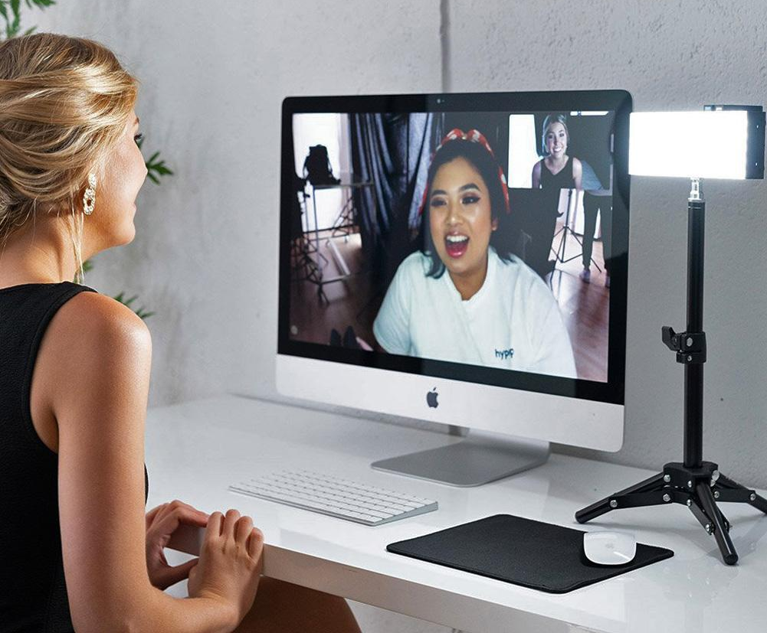
Setting – Lighting & Space
Room lighting
Make sure the room you are in has good lighting hitting your face so everyone can see you clearly or sit in front of a window with natural light coming in if your session is during the day.
Note: Avoid sitting under fluorescent lights as they create a flicker.
Bright walls
You can also sit in front of a bright wall which will reflect lights onto your face.
Table lighting
If you have a table lamp, you can set it up next to your computer or device.
Use Virtual Background
You may use also use Virtual Background. On the next slide you can download the GCBSS Virtual Background.

Slide 19
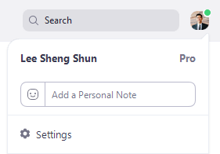
Use Virtual Background
Download GCBSS background
to your desktop, laptop or tablet
Click your profile picture, then click Settings.
Select Virtual Background.
Note: If you do not have the Virtual Background tab and you have enabled it on the web portal, sign out of the Zoom Desktop Client and sign in again.
If you have a physical green screen set up, you can then click on your video to select the correct color for the green screen.

Slide 20
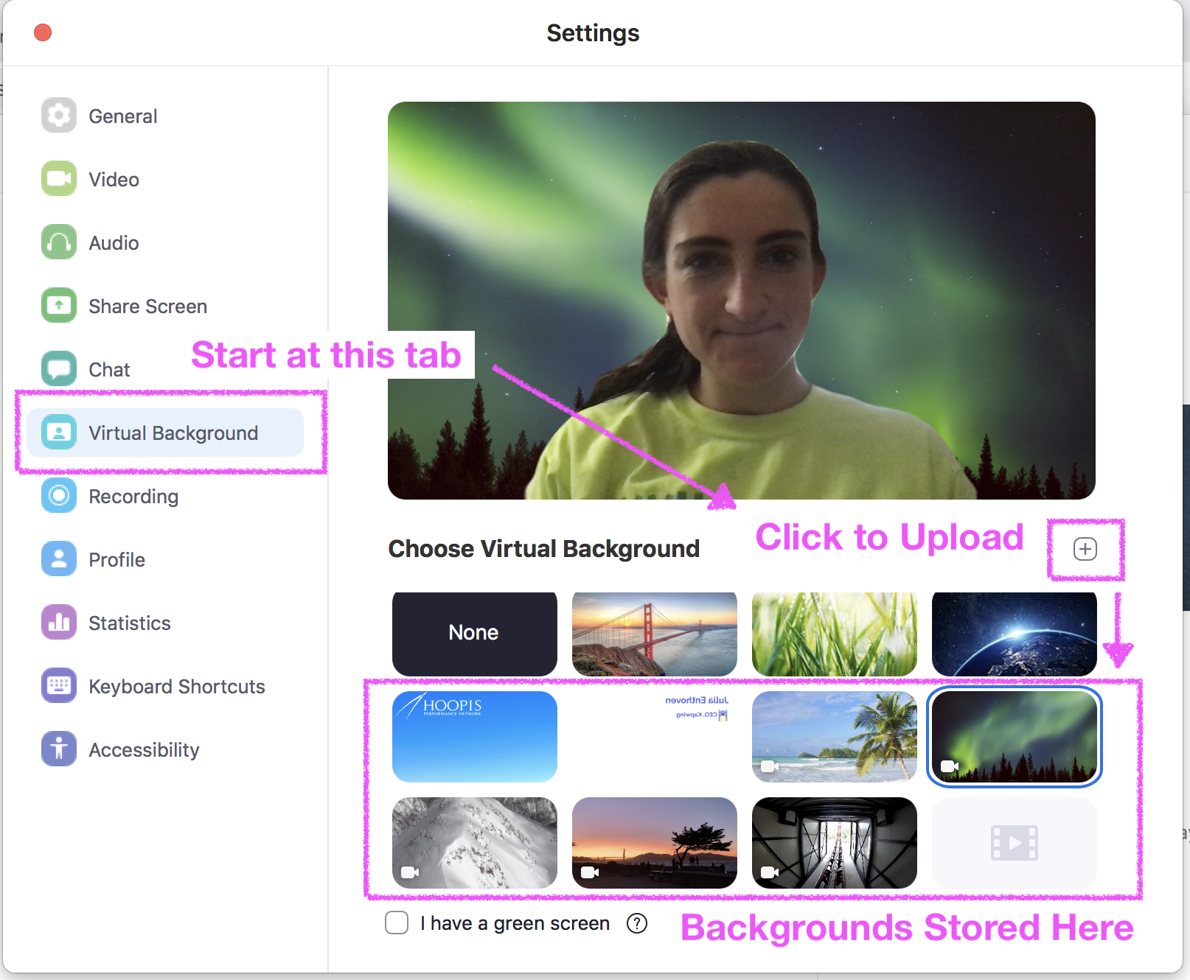
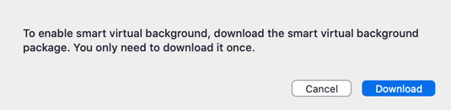
Use Virtual Background
Click + and choosing your downloaded Virtual Background image location in your device. If prompted, click Download to download the package for virtual background without a green screen.
Note: After you select an option, that virtual background will display during your meetings.
To disable Virtual Background, choose the option None.

Slide 21
Use Virtual Background
If you have a physical green screen set up, you can then click on your video to select the correct color for the green screen.
Click + and choosing your downloaded Virtual Background image location in your device. If prompted, click Download to download the package for virtual background without a green screen.
Note: After you select an option, that virtual background will display during your meetings.
To disable Virtual Background, choose the option None..

Slide 22
MORE INFOMATION
Here are some useful guide and tips on Video Conferencing.
  4 Tips for Getting the Most Out of Zoom Video Conferencing
    Joining & Configuring Audio & Video in Zoom
      How to use Zoom's Virtual Backgrounds
        Tips to Help You Meet Like a Pro
          Video Conferencing Setup Tips

Slide 23
ANY QUESTIONS?
CONTACT US
Global Conference on Business and Social Sciences Series
IB Tower, Level 33, 8, Jln Binjai,
50450 Kuala Lumpur, Malaysia
Tel: +603 2117 5006
Mobile/ WhatsApp: +6017-3690275
For General Inquiries: info@gcbss.org
For Other Inquiries: admin@gatrenterprise.com

Slide 24

















Collaborators

